Slide 1
Email Topic Classification with Natural Language Processing
—
Proof of Concept

Slide 2
Background
—

Slide 3
Background
—
Underwriting Support (commonly referred to as UW Support) is a team within Sales and Service.
It’s made up of underwriters with strong experience and high delegated consumer underwriting authority.

Slide 4
Background
—
UW Support supports the customer and intermediary facing Sales and Service teams by:
Giving guidance on complex underwriting scenarios
Approving quotes and requests above the underwriting consultants’ underwriting authority
Providing one-on-one coaching
Assisting with credit control and processing issues
Authorising Solvit batches
Managing the “Underwriting Academy” by:
Writing exam papers
Creating and delivering training material
Grading exams

Slide 5
Background
—
UW Support also:
Provides input on company-wide underwriting stances
Gives recommendations on outcomes or terms where underwriting concerns are identified during a claim
Writes voidance and declinature letters

Slide 6
The Business Problem
—

Slide 7
The Business Problem
—
UW Support’s primary communication channel is email (via a shared inbox in Outlook). They receive around 120 emails per day.
The emails that come through are free-format and there’s no real structure their content.
This means that there’s no accurate way of measuring at scale what the emails they receive are about.

Slide 8
The Business Problem
—
Being able to answer questions like:
Do the customer facing consultants require assistance with high-value vehicle referrals more or less often than referrals for homes in flood-prone areas?
Is the number of quote approval requests for BodyCorp properties increasing month-on-month, and if so by how much?
Are discounts requested more frequently for some products than others?
would mean that UW Support could make more informed decisions about what training to provide, what topics to cover in Underwriting Academy exams, where to advocate for changes to underwriting stances etc.

Slide 9
Data Collection
—

Slide 10
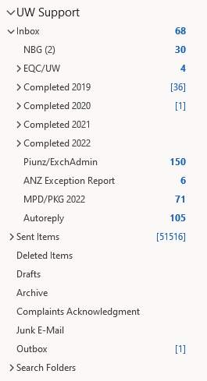
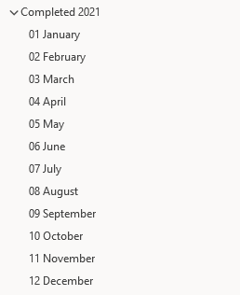
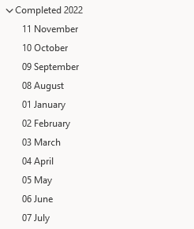
Data Collection
—
Luckily, historic emails are moved into structed folders within Outlook. This makes it relatively easy to programmatically iterate through the folders and download the contained emails.

Slide 11
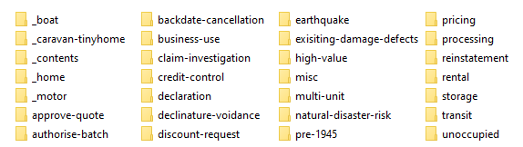
Data Collection
—
200 emails from each month in Jan-2022 through to Sep-2022 were extracted from Outlook and saved to a network drive
28 distinct subfolders were created in the drive for each topic that the model should be able to predict
The emails were manually labelled by placing a copy in each topic-folder that applied. One email can appear in multiple sub-folders if it was about multiple topics

Slide 12
Data Collection
—
The 28 folders were then iterated through, and the following details of each email contained within was added to a dataframe:
from_name
from_address
sent_date
to_address
cc_address
bcc_address
subject
body
number_attachments
label

Slide 13
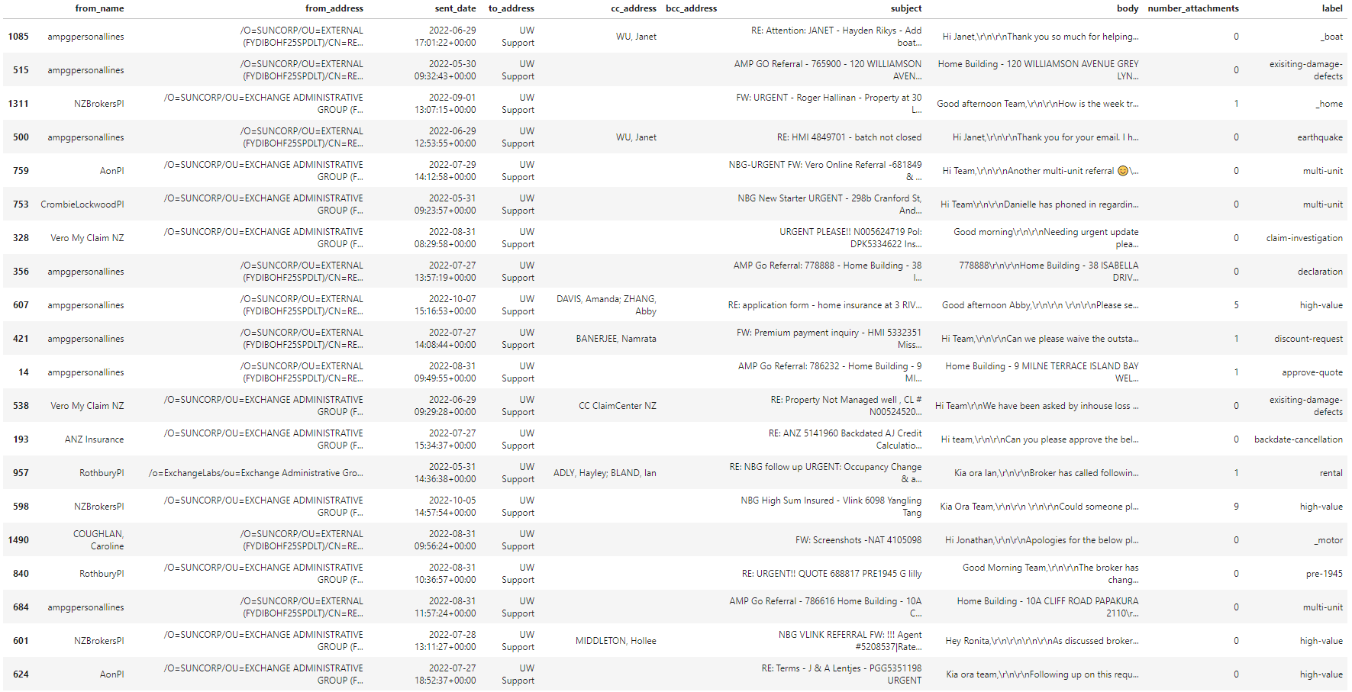
Data Collection
—

Slide 14
Data Exploration
—

Slide 15
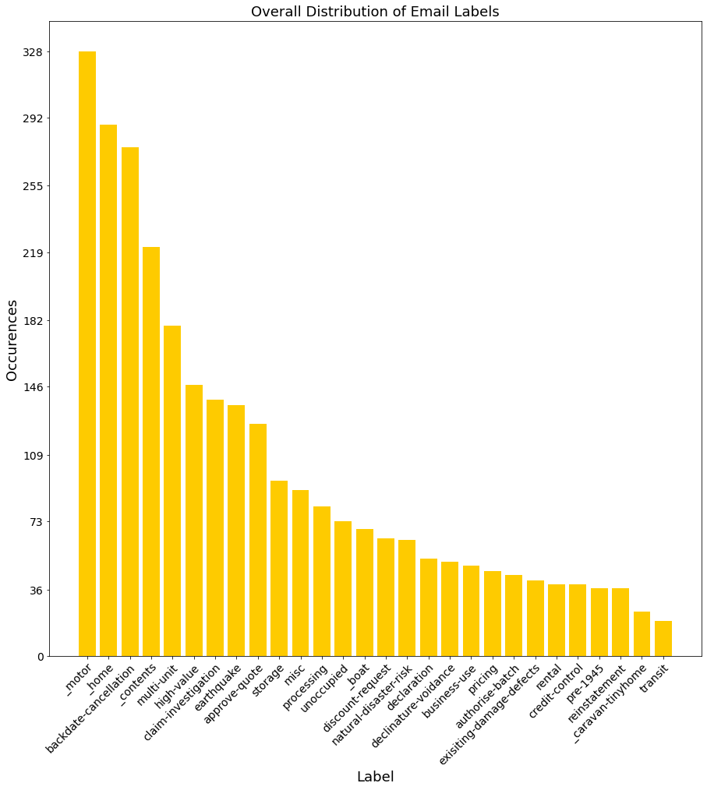
Data Exploration
—

Slide 16
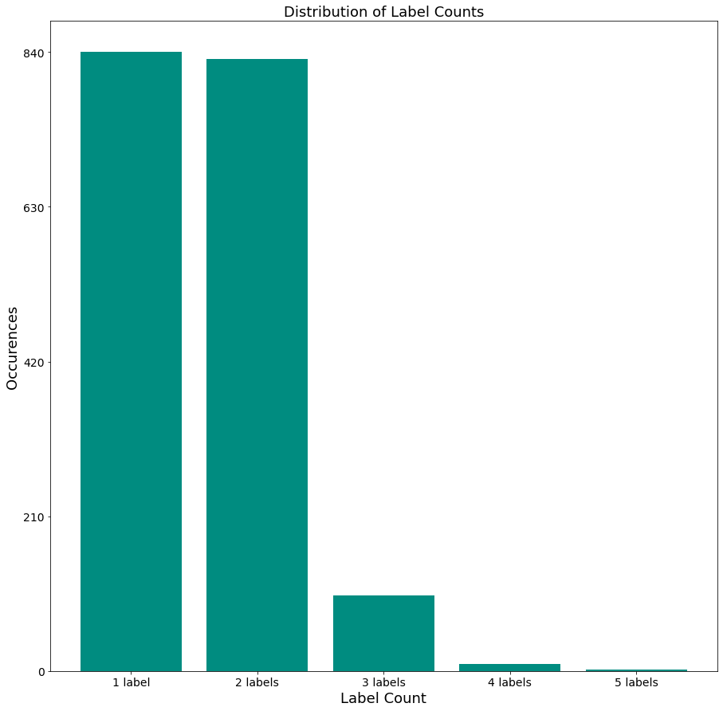
Data Exploration
—

Slide 17
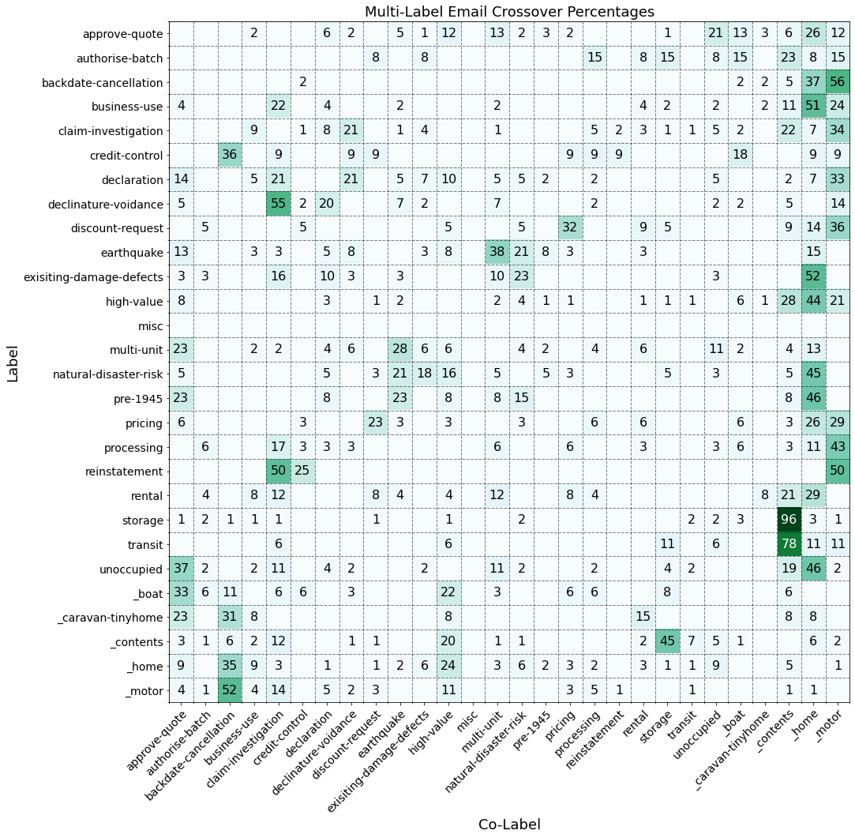
Data Exploration
—

Slide 18
Data Exploration
—
Key points:
There is a very unbalanced distribution of labels:
A stratified train-test split should be used
Synthetic oversampling might be useful
A large batch size should be used when training
The percentage of the most and least represented labels (_motor at 11.49% and transit at 0.67%) should be considered when word embedding
It’s more common than not for emails to have multiple labels, and most combinations of labels aren’t represented in the data:
The eventual model needs to be able to predict multiple labels for a single email, independently of one another. E.g. if an email is about an unoccupied multi-unit property, the model needs to be able to apply two distinct labels rather than a single label representing both:
“multi-unit”, and “unoccupied”; not “multi-unit, unoccupied”

Slide 19
Data Cleaning and Feature Engineering
—

Slide 20
Data Cleaning and Feature Engineering
—
An example of the body of an email:
Hi Team, Can I please have this batch approved broker is requesting terms ðŸ˜Š [cid:image003.png@01D88CA2.6B28DBA0] Kind regards, June Brassett (She/Her) Customer Service and Underwriting Consultant Vero Insurance New Zealand Ltd Vero Centre, 48 Shortland Street Private Bag 92120, Auckland 1142 P 0800 543 963 E nzbrokerspi@vero.co.nz<mailto:nzbrokerspi@vero.co.nz> | W www.vero.co.nz<https://clicktime.symantec.com/3HxrwZBKerE7K9qXWVNFBPj7Vc?u=http%3A%2F%2Fwww.vero.co.nz%2F> B Attachments: image001.jpg <http://evault4.int.corp.sun/EnterpriseVault/Search/htmlview.aspx?VaultId=16179DDEE78E3A848A1C7472C2B94A0C11110000EVSITE&SavesetId=202207077181215~202206300457060000~Z~5089DCDD2CD3A3F2CEEF3B8349BD01B1&AttachmentId=1> (5 KB) image002.gif <http://evault4.int.corp.sun/EnterpriseVault/Search/htmlview.aspx?VaultId=16179DDEE78E3A848A1C7472C2B94A0C11110000EVSITE&SavesetId=202207077181215~202206300457060000~Z~5089DCDD2CD3A3F2CEEF3B8349BD01B1&AttachmentId=2> (1 KB) doc00128220220614073201.pdf <http://evault4.int.corp.sun/EnterpriseVault/Search/htmlview.aspx?VaultId=16179DDEE78E3A848A1C7472C2B94A0C11110000EVSITE&SavesetId=202207077181215~202206300457060000~Z~5089DCDD2CD3A3F2CEEF3B8349BD01B1&AttachmentId=3> (216 KB) image003.png <http://evault4.int.corp.sun/EnterpriseVault/Search/htmlview.aspx?VaultId=16179DDEE78E3A848A1C7472C2B94A0C11110000EVSITE&SavesetId=202207077181215~202206300457060000~Z~5089DCDD2CD3A3F2CEEF3B8349BD01B1&AttachmentId=4> (5 KB) image004.jpg <http://evault4.int.corp.sun/EnterpriseVault/Search/htmlview.aspx?VaultId=16179DDEE78E3A848A1C7472C2B94A0C11110000EVSITE&SavesetId=202207077181215~202206300457060000~Z~5089DCDD2CD3A3F2CEEF3B8349BD01B1&AttachmentId=5> (7 KB) image005.png <http://evault4.int.corp.sun/EnterpriseVault/Search/htmlview.aspx?VaultId=16179DDEE78E3A848A1C7472C2B94A0C11110000EVSITE&SavesetId=202207077181215~202206300457060000~Z~5089DCDD2CD3A3F2CEEF3B8349BD01B1&AttachmentId=6> (8 KB)

Slide 21
Data Cleaning and Feature Engineering
—
For the purposes of predicting the topic of the email, only the subject and body features will be used. To improve their useability the following “cleaning” steps were taken:
All punctuation; including tabs, line-breaks, and returns; was removed
The strings were tokenized; split into a list on the spaces
All tokens were converted to lower case
Any token that ended in a file extension (e.g. jpg, pdf) was removed
Any token that ended in a top-level domain (e.g. conz, com) was removed
Any tokens containing numerical digits were removed (except for a small number of pre-defined allowed tokens)
Any tokens that were less than 2 or more than 15 characters long were removed
Any tokens in one of two lists of stopwords was removed
Tokens were “stemmed” using the Snowball stemming algorithm

Slide 22
Data Cleaning and Feature Engineering
—
Stemming maps different forms of the same word to a common stem. This mitigates against multiple forms of the same word being used as separate and superfluous predictors in the model.
For example:
“Could you please approve quote 123456?
“Can quote 123456 please be approved?”
“I need approval for quote 123456 please.”

Slide 23
Data Cleaning and Feature Engineering
—
[‘batch', 'approv', 'broker', 'request', 'term', 'street', 'privat', 'bag’]

Slide 24
Data Cleaning and Feature Engineering
—
The labels were encoded; converted to an array of ones and zeroes
E.g. for the set of possible labels: (“Label 1”, “Label 2”, “Label 3”, “Label 4”, “Label 5”), each label(s) is converted into an array with a one in the position of the label(s) in the set, and zeroes everywhere else.
So “Label 3” becomes [0, 0, 1, 0, 0]
“Label 5” becomes [0, 0, 0, 0, 1]
“Label 2”, and “Label 4” becomes [0, 1, 0, 1, 0]

Slide 25
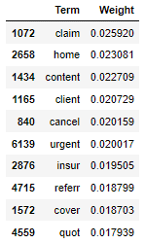
Data Cleaning and Feature Engineering
—
A TF-IDF matrix was created based on the cleaned subject and body. TF-IDF (Term Frequency–Inverse Document Frequency) is a value between 0 and 1 that measures how “important” a word is to a email.
Words that appeared in less than 0.25% and more than 25% of all emails were excluded. Single words, and combinations of between 2 and 5 words were included.
The resulting TF-IDF vocabulary contains 6,446 words.

Slide 26
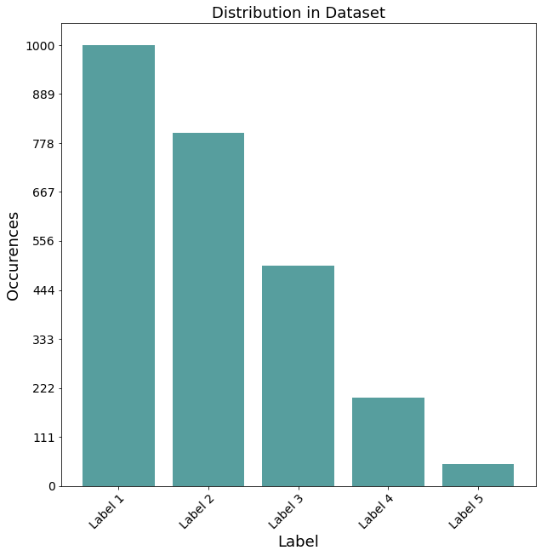
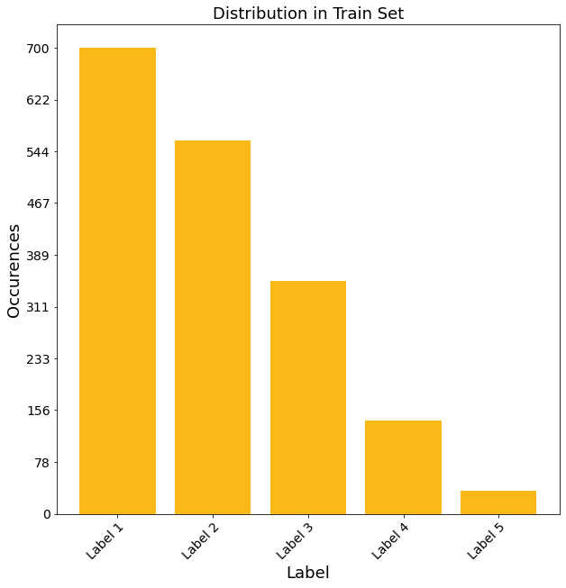
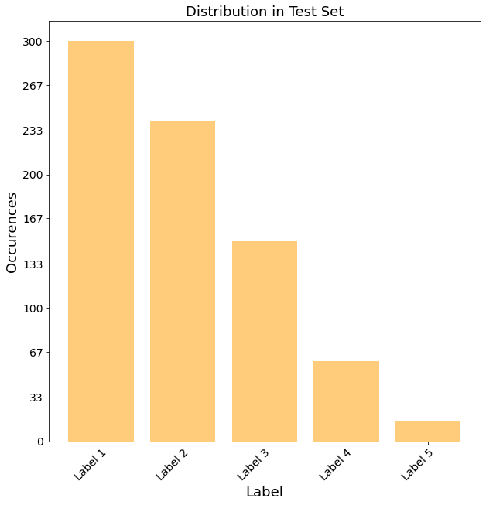
Data Cleaning and Feature Engineering
—
The data was split into training and testing sets, of 70% and 30% respectively.
The model is trained on the emails in the training set, and it’s predictions are validated against the emails in the test set.
A stratified split was done, so the distribution of the labels is the same in both sets.

Slide 27
Data Cleaning and Feature Engineering
—
Due to the imbalanced distribution of labels in the data the performance of the models would likely be improved by creating synthetic points for the under-represented labels. This was implemented with SMOTE (Synthetic Minority Oversampling Technique), which creates new data points for a particular label based on the original data points that have that label.

Slide 28
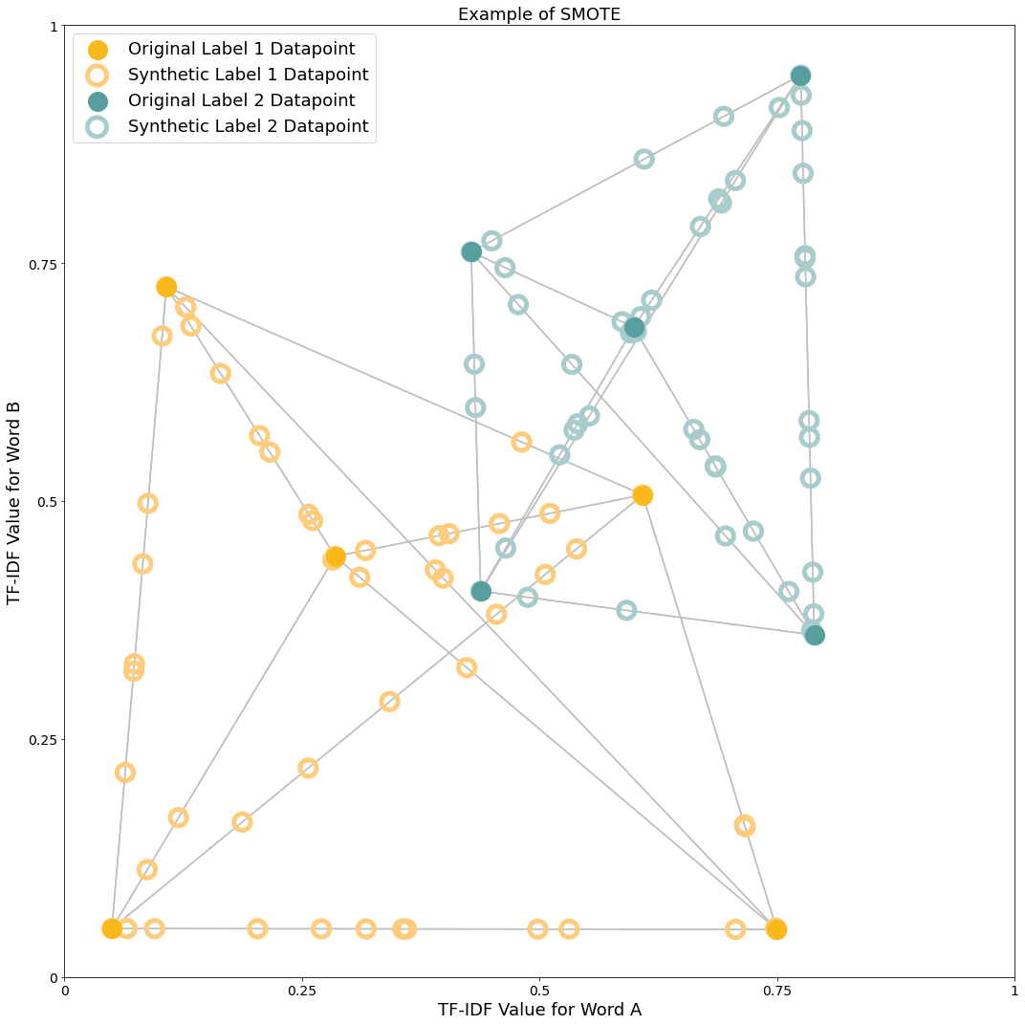
Data Cleaning and Feature Engineering
—

Slide 29
Model Training and Evaluation
—

Slide 30
Data Cleaning and Feature Engineering
—
Two simples models were trained:
A neural network
An XGBoost Classifier
Both output normalised probabilistic predictions, i.e. an array containing the probability that the model “thinks” each label should be applied to the email, where all probabilities sum to 1
Label 1
Label 2
Label 3
Label 4
Label 5
0.05
0.1
0.35
0.1
0.4
The model “thinks” there’s a 5% chance the email should have “Label 1”, a 10% chance the email should have “Label 2”, a 35% chance the email should have “Label 3”, a 10% chance the email should have “Label 4”, and a 40% chance the email should have “Label 5”

Slide 31
Data Cleaning and Feature Engineering
—
Label 4
Label 2
Label 5
Label 1
Label 3
0
1
0
1
Label 1
Label 2
Label 3
Label 5
Label 4

Slide 32
Model Training and Evaluation
—
Label 1
Label 2
Label 3
Label 4
Label 5
0.03
0.61
0.01
0.3
0.05
0.033
1.00
0.00
0.483
0.067
0
1
0
0
0
scaled between 0 and 1
rounded to the nearest integer
Label 1
Label 2
Label 3
Label 4
Label 5
0.07
0.13
0.3
0.1
0.4
0.00
0.182
0.697
0.091
1.00
0
0
1
0
1
scaled between 0 and 1
rounded to the nearest integer

Slide 33
Model Training and Evaluation
—
Types of prediction outcomes:
True Positive When the model does predicts a label that the test email does have
True Negative When the model doesn’t predict a label that the test email doesn’t have
False Positive When the model does predict a label that the test email doesn’t have
False Negative When the model doesn’t predict a label that the test email does have
E.g.: if an email in the test set has the labels [“Label 2”, “Label 4”, and “Label 5”] and the model predicts [“Label 1”, and “Label 2”] there are:
one True Positive (“Label 2), one True Negative (“Label 3”),
one False Positive (“Label 1”), and two False Negatives (“Label 4”, and “Label 5”)

Slide 34
Model Training and Evaluation
—
The following are five metrics used to review the performance of the models:
Accuracy
What percentage of emails in the test set have all labels predicted exactly; no false positives and no false negatives?
Precision
What percentage of the total positive predictions are true positives?
Recall
What percentage of labels in the test set have true positive predictions?
One True Positive
What percentage of emails in the test set have at least one true positive predicted?
No False Positives
What percentage of emails in the test set don’t have any false positives predicted?

Slide 35
Model Training and Evaluation
—
 | Accuracy | Precision | Recall | One True Positive | No False Positives
Neural Network | 73.63% ✓ | 85.44% | 87.03% ✓ | 87.28% ✓ | 80.16%
XGBoost | 64.99% | 86.09% ✓ | 82.22% | 86.58% | 81.56% ✓

Slide 36
Model Training and Evaluation
—
For a weight between 0 and 1, the Ensemble probabilities are:
Neural Network
Ensemble
XGBoost
Label 1
Label 2
Label 3
Label 4
Label 5
y₁
y₂
y₃
y₄
y₅
0.05
0.1
0.35
0.1
4
0.1
0.05
0.4
0.05
0.4
=
+
* weight
* (1- weight)

Slide 37
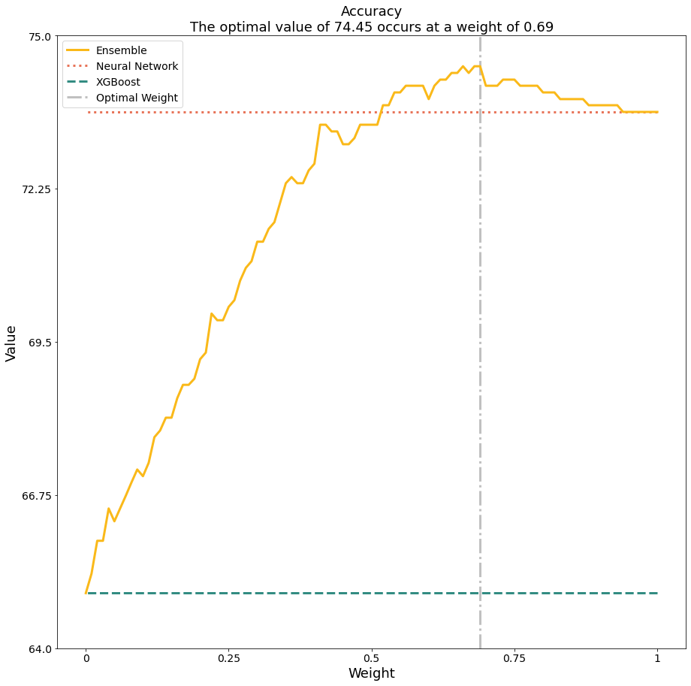
Model Training and Evaluation
—

Slide 38
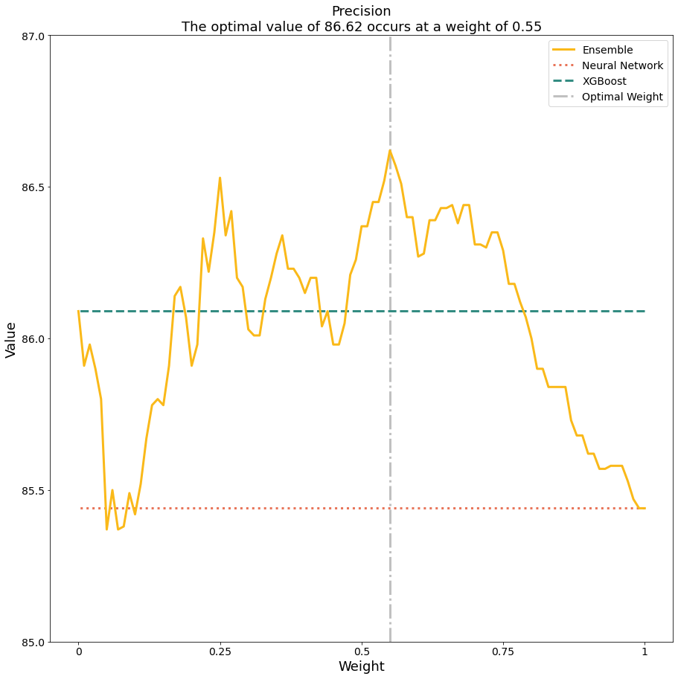
Model Training and Evaluation
—

Slide 39
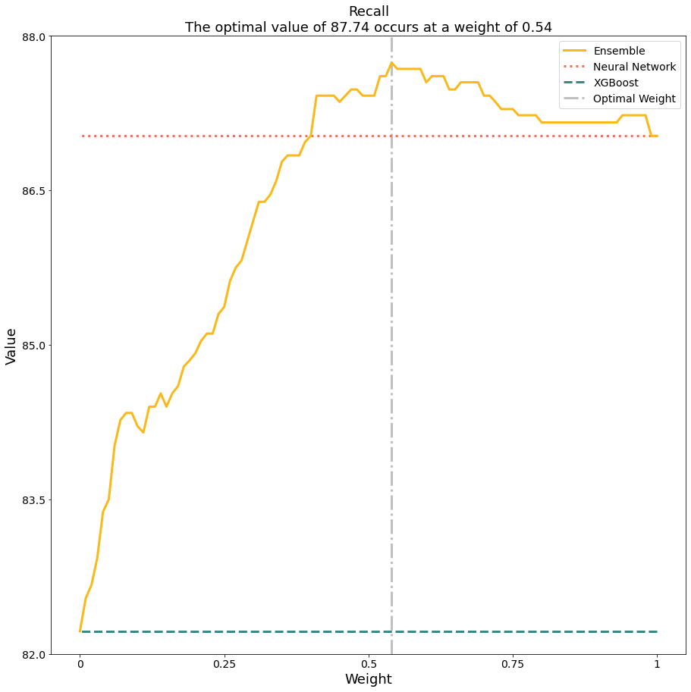
Model Training and Evaluation
—

Slide 40
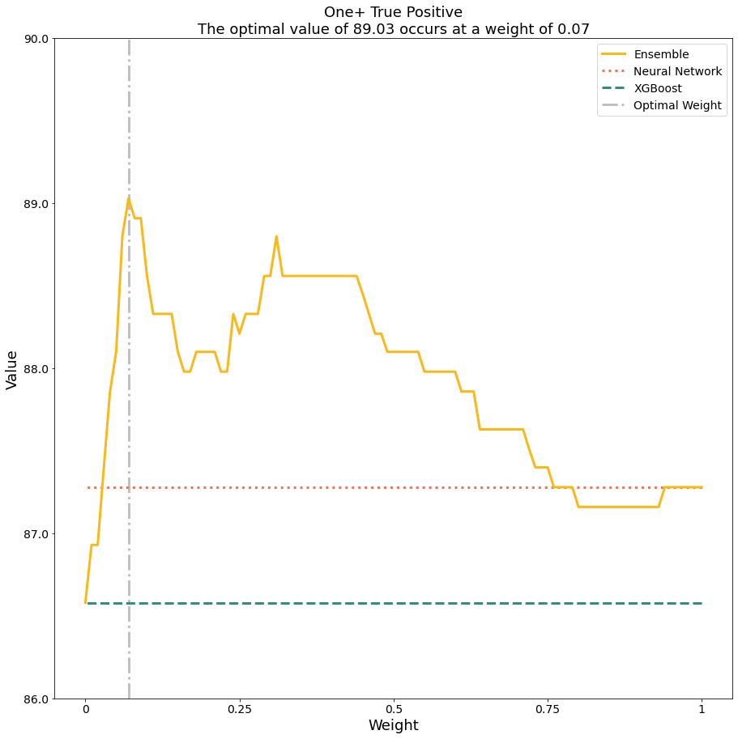
Model Training and Evaluation
—

Slide 41
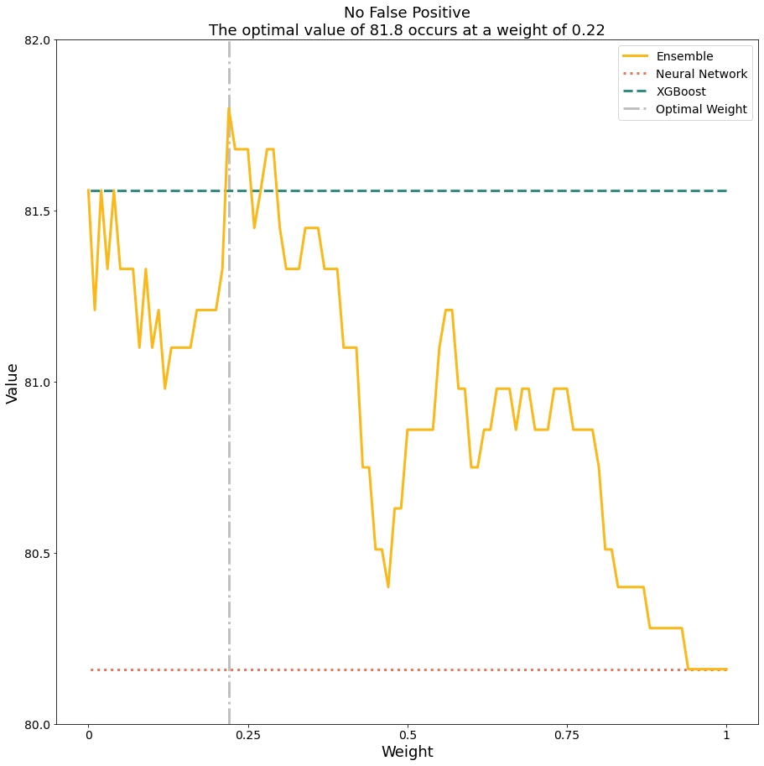
Model Training and Evaluation
—

Slide 42
Model Training and Evaluation
—
 | Accuracy | Precision | Recall | One True Positive | No False Positives
Neural Network | 73.63% | 85.44% | 87.03% | 87.28% | 80.16%
XGBoost | 64.99% | 86.09% | 82.22% | 86.58% | 81.56% ✓
Ensemble Weight = 0.545 | 73.98% ✓ | 86.62% ✓ | 87.74% ✓ | 88.10% ✓ | 81.10%

Slide 43
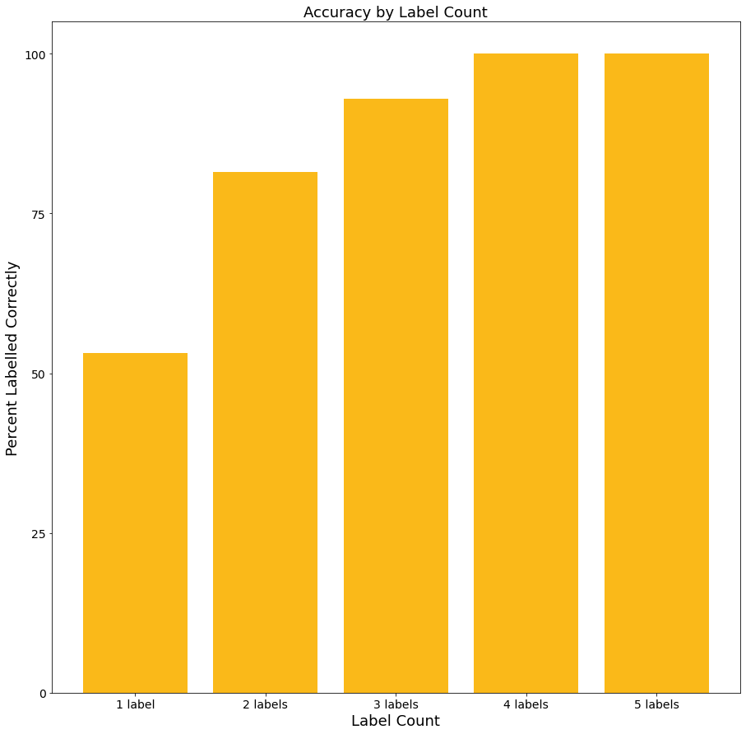
Model Training and Evaluation
—

Slide 44
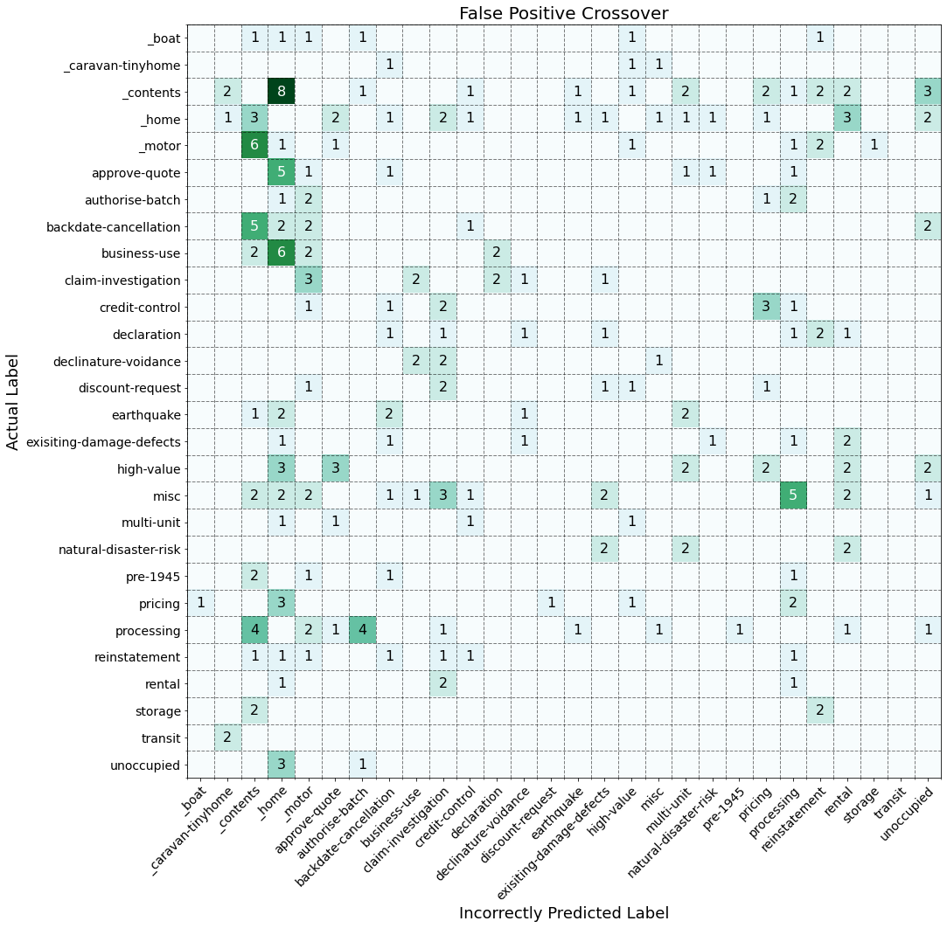
Model Training and Evaluation
—

Slide 45
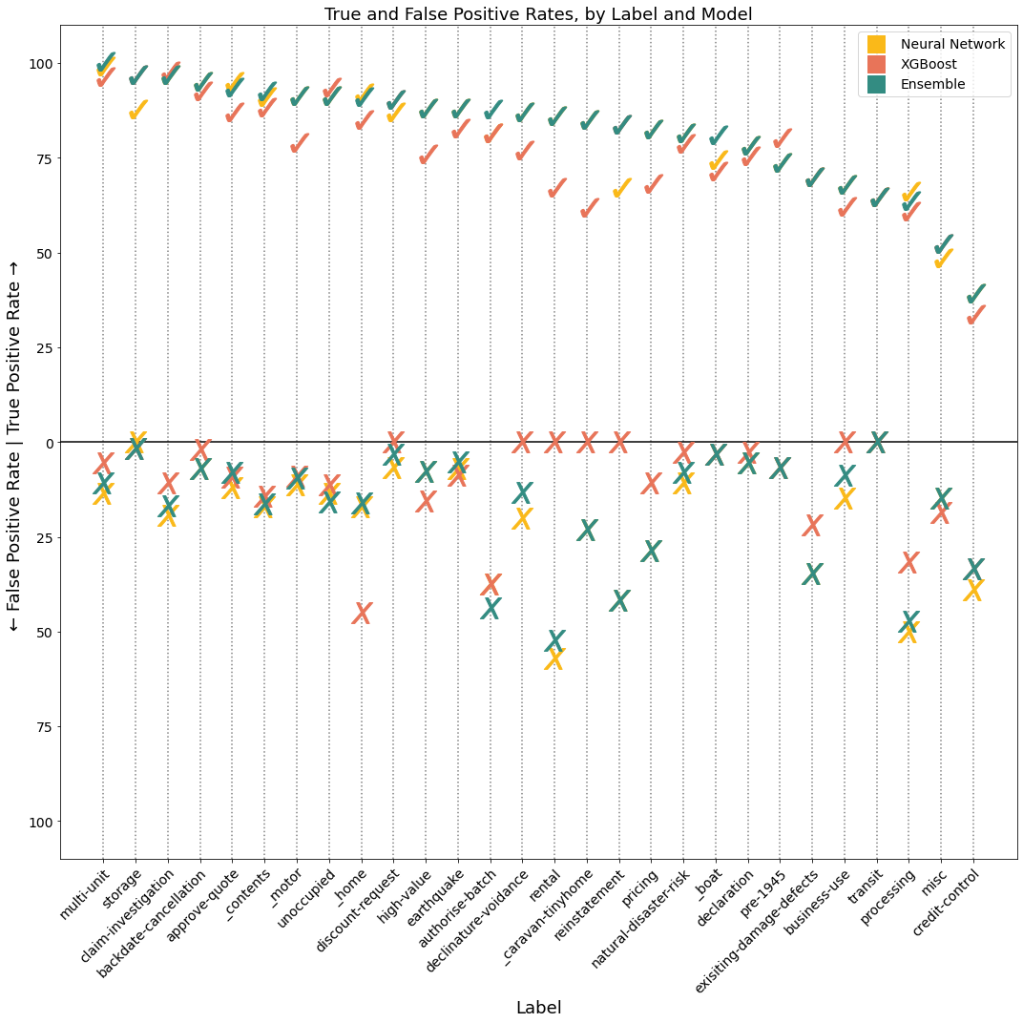
Model Training and Evaluation
—

Slide 46
Next Steps
—

Slide 47
Next Steps
—
Short Term:
Engage with UW Support
Continue building the train-test data set
Attempt dimensionality-reduction on TD-IDF matrix
Implement a word embedding step using GloVe, or BERT etc
Fine-tune the models

Slide 48
Next Steps
—
Medium to Long Term:
Create an automated monthly report
Explore what other useful information could be extracted, e.g. email response times by label
Embed the model in an Outlook COM add-in that automatically labels emails as they come into the inbox
See if there are other teams within Suncorp that would benefit from a similar model (the customer-facing teams for example)

Slide 49
Questions?

